Slide 1

Analyzing Global Mental Health and Suicide Rate

Slide 2

GROUP 6
Pratinav Jinwal
Shubham Kharbanda
Karan Tejraj Kotian
Divyajot Singh Mankan
Iqbaldeep Singh Bhullar

Slide 3
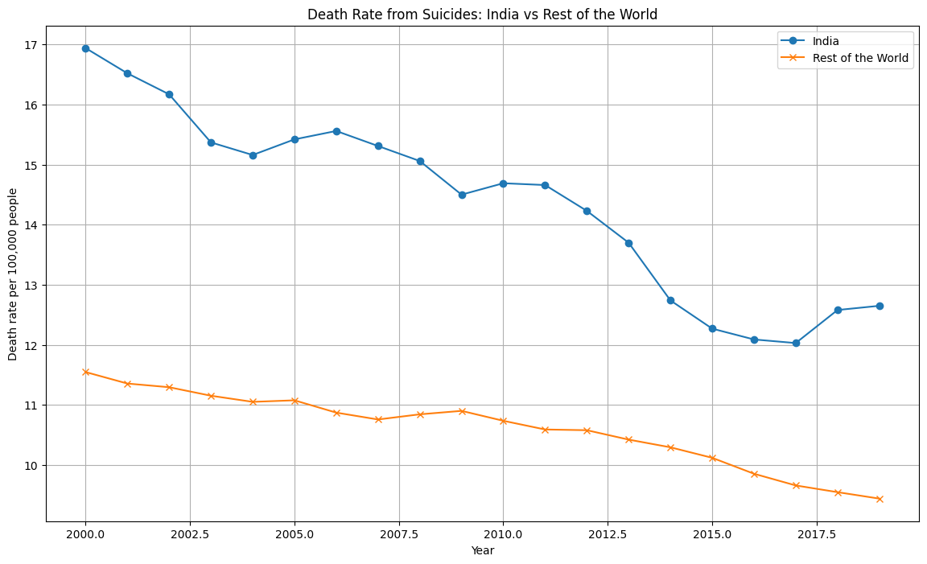
INTRODUCTION
Emerging Positives: India has seen a commendable decline in suicide rates, a reflection of improving mental health outcomes and proactive measures.
Comparative Progress: When placed side by side with the world, India's significant downturn in suicide rates since the early 2000s stands out, suggesting the effectiveness of its health policies and societal efforts.
Analytical Focus: Delve into the dynamics of suicide rates, understanding India's stride against global trends, with an eye on mental health initiatives and cultural shifts.
Presentation Goals: To highlight the optimistic pattern of India's suicide rate decline through data-driven insights and encourage dialogue on the sustained success of mental health interventions globally and within India.

Slide 4
Data Preparation Steps for Global Suicide Rate Analysis
Filtering Non-Indian Data: To focus on the "Rest of the World" data, we first exclude data pertaining to India. This creates a subset of the original dataset that will allow for a comparative analysis.
Aggregation of Numeric Columns: We then aggregate this subset by the 'Year' column, ensuring to include only the numeric columns. The groupby function in combination with mean() computes the average of all numeric columns for each year. This simplifies the dataset by providing annual averages, which are easier to analyze and visualize.
Reshaping the Data: A reset_index() method is applied to the grouped data to transform it from a grouped object back into a DataFrame. This step is essential for the data to be used in further analysis or visualizations.
Evaluating Data Completeness: The code checks for missing values across all columns in the original dataset with data.isnull().sum(). Understanding the presence of missing values is crucial to ensuring the quality of the analysis.
Data Type Confirmation: We verify the data type of the 'Year' column using data['Year'].dtype. Ensuring that 'Year' is of the correct data type is important for time series analysis.
India-Specific Data Extraction: A subset of data exclusively representing India is created for a focused analysis on the country.
Prepared Dataset Assignment: Finally, the prepared "Rest of the World" dataset is stored in a variable, making it ready for further analysis.

Slide 5
Stationarity Check and Data Transformation
Initial Stationarity Check with ADF Test:
Non-stationary results for India and Rest of the World (p-values > 0.99).
Data Transformation:
Applied first-order differencing to India's data.
Post-differencing ADF results: Statistic: -3.6689, p-value: 0.0046 (indicating stationarity).
Results Highlight
Transition from non-stationary to stationary data crucial for ARIMA modeling.

Slide 6
Determining ARIMA Parameters
Analysis of ACF and PACF:
Used to determine ARIMA model parameters (p, d, q).
Parameter Insights:
p-value identified as 1 (based on PACF cut-off).
d-value already set to 1 (differencing order).
q-value suggested as 1 (based on ACF plot).
Results Highlight:
Parameters for ARIMA model identified as (1, 1, 1) for India's data.

Slide 7
ARIMA Predictive Analysis
ARIMA Model Fitting:Fitted ARIMA(1,1,1) model to both datasets.
Five-Year Forecast:Predicted suicide rates for the next 5 years.
Results Highlight:
India's Forecast: Shows a slight increase then stabilizes.
Rest of the World's Forecast: Continues a slight downward trend.

Slide 8
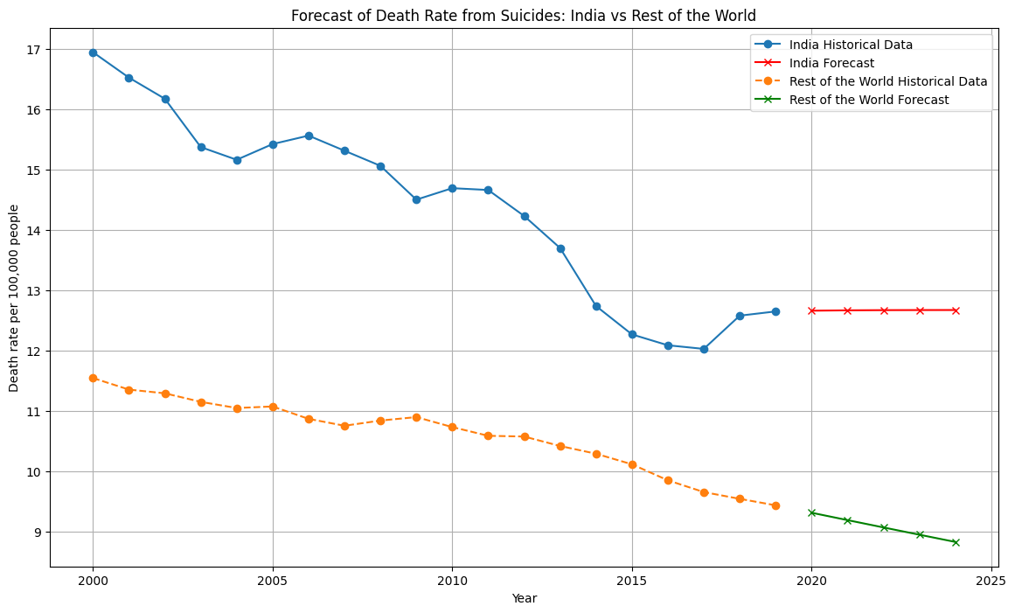

Slide 9
Smoothing and Projecting with Moving Averages
Applying Simple Moving Average (SMA):
Calculated a 3-year SMA for both datasets.
Future Trend Projection Using SMA:
Extended the last SMA value into the next 5 years.
Results Highlight:
India's Trend: Recent average suggests a stabilized future rate.
Rest of the World's Trend: Consistent decline suggests a continuation of the downward trend.

Slide 10
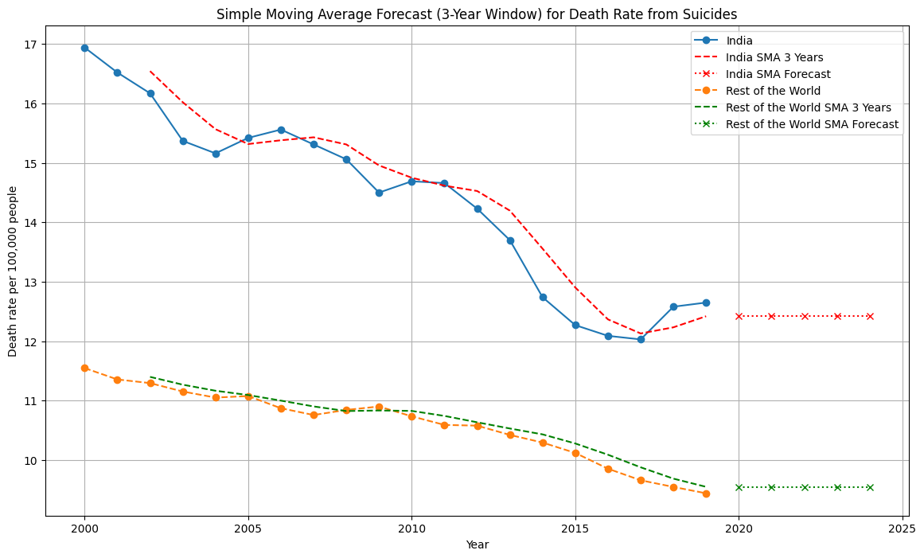

Slide 11
Analysis of Death Rates Due to Self-harm and Violence (1990-2019)
Approach and Methodology
Data Preparation: Excluded the last 5 years from the dataset to serve as a test set for evaluating our forecasting model's performance.
Moving Averages: A simple yet powerful method to smooth out short-term fluctuations and highlight longer-term trends in time series data.
Exponential Smoothing: Applied Holt-Winters exponential smoothing to account for trends over time without requiring a fixed statistical model.

Slide 12
Forecasting and Model Evaluation
Forecasting Methodology:
Applied a 5-year moving average and Exponential Smoothing for forecasting last 5 years' death rates due to violence.
Results:
MAE (Moving Average): Calculated Mean Absolute Error for moving average forecasts was found to be insightful for model accuracy.
RMSE (Moving Average): The Root Mean Square Error further validated the forecast reliability.
MAE (Exponential Smoothing): Demonstrated slight improvements in forecasting accuracy over the moving average method.
RMSE (Exponential Smoothing): Indicated consistent model performance, aligning closely with MAE findings.
Model Evaluation: Both models exhibited robust predictive capabilities, with exponential smoothing slightly outperforming the moving average approach in terms of error metrics.

Slide 13
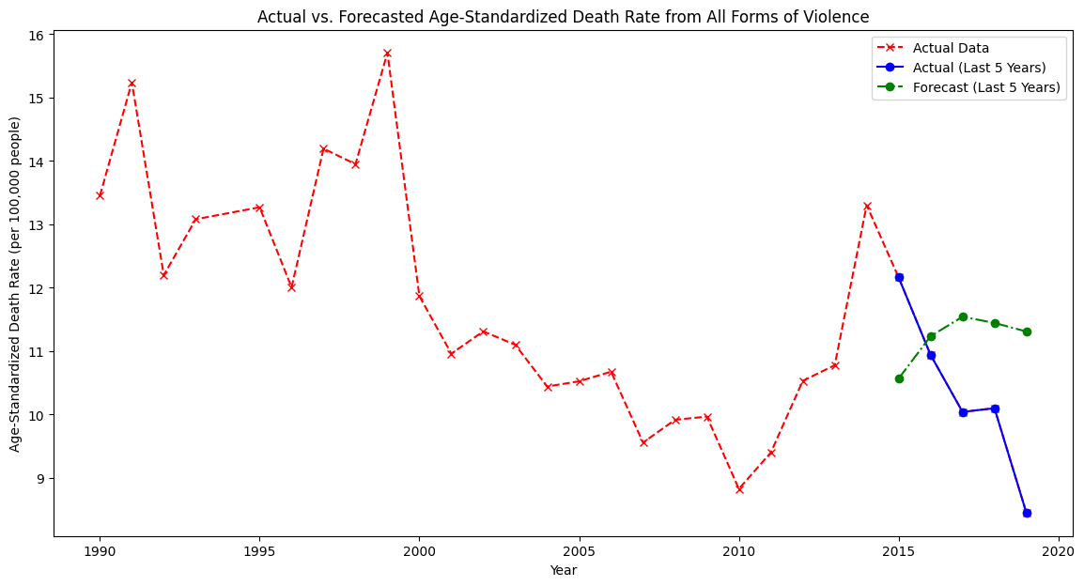
Simple Moving Average Forecasting

Slide 14
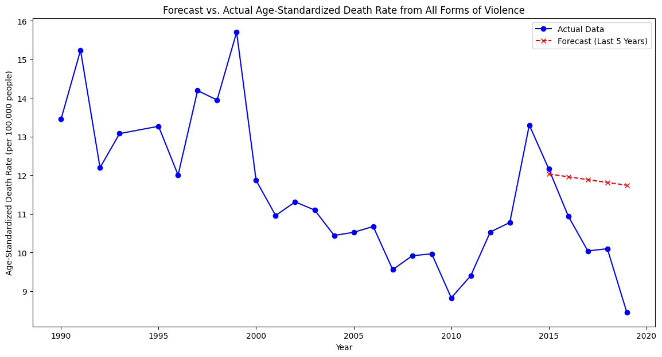
Exponential Smoothing

Slide 15
Insights and Implications
Summary of Findings: The analysis highlighted a general downward trend in death rates from violence, with the forecasting models providing valuable insights into future rates.
Model Performance: The Exponential Smoothing model showed marginally better performance, suggesting its suitability for similar time series data in public health.
Policy Implications: The insights from this analysis can inform policymakers about the effectiveness of interventions over time and help in prioritizing resource allocation.

Slide 16
Results to Include:
MAE and RMSE for the last 5 years using exponential smoothing: MAE = [Your Calculated Value], RMSE = [Your Calculated Value]
RMSE using ARIMA Model for India vs rest of the World is 0.62

